Slide 1

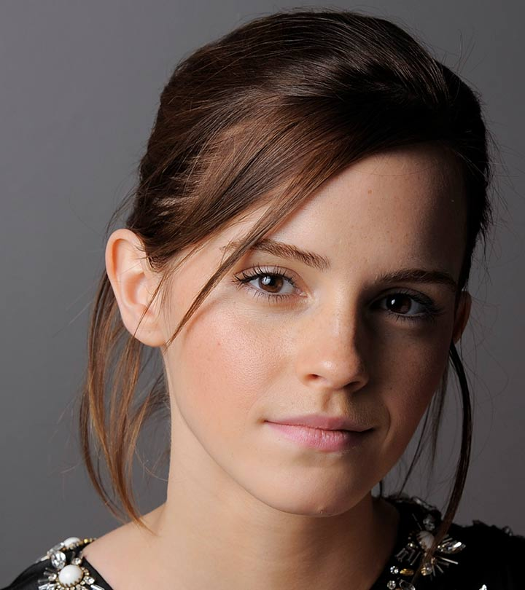
Emma Watson
By Phoebe Celeste Speirs

Slide 2
Contents
Early life
Why she is famous?
What films she’s played in?

Slide 3
Early life
Emma Charlotte Duerre Watson (born 15 April 1990)[4] is an English actress, model, and activist. Born in Paris and brought up in Oxfordshire, Watson attended the Dragon School and trained as an actress at the Oxford branch of Stagecoach Theatre Arts.

Slide 4
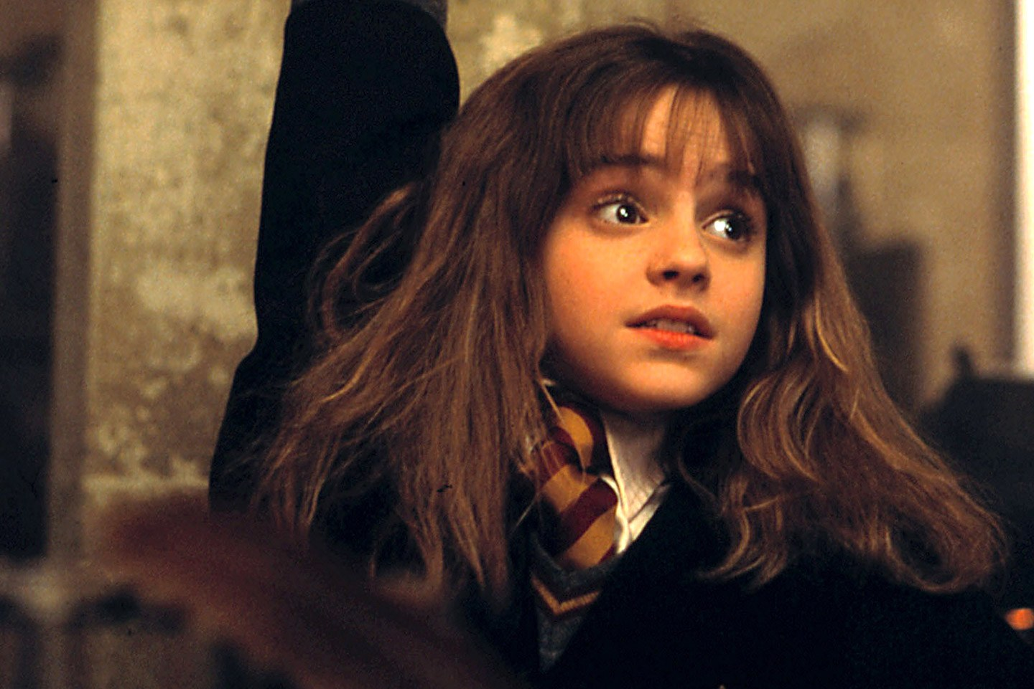
What films she’s played in?
Harry potter movies
Beaty and the beast
The circle
And many more

Slide 5
Personal life
Rents a apartment in London
She is 28

Slide 6

Any questions?

